Slide 1

TEXT ADVENTURE By Team 10

Slide 2



OUR TEAM
NS GAGAN
ENG19CS0194
NAMITHA K
ENG19CS0197
NARMATHA T
ENG19CS0198
NIVEDHITHA
ENG19CS0211
PAVAN
ENG19CS0220

Slide 3

ABSTRACT
> The popularity of playing games has grown immensely and simple fun and visual adventurous game that’s based on complete interchange of sequence of texts that can kill boredom.
> The project consists of 2 pre-planned stories with many decisions to be taken at regular intervals. The decision that the user takes will lead the user to that part of the story accordingly. The regular decisions will make the story seem more
interactive and give a virtual tour of the story.

Slide 4
ABSTRACT
> Gaming is a meaningful and purposeful activity for gamers. The push and pull influences on amount of gaming can occur in real life or virtually. Gaming is a purposeful activity and is a community as a sub-culture.
> Basic design in this is done using conditional statements like if-else statements, switch statements, random integer function, pygame modules and playsound modules.

Slide 5
INTRODUCTION
> A normal book would make the reader just read what the author has
imagined and the reader could probably think of an alternate way to
handle a situation.
> Here’s this game for those who always like things a little different
and in their own way. Change the story with the different options
provided and play the way the user likes.
Pygame has slideshow viewer designed for advanced pictorial features.

Slide 6
INTRODUCTION
> This project consists of two stories, one a fictional story and an
another adventure at the woods.
> Section 3 covers Problem statements.
Section 4 includes objectives.
Section 5 portrays methodology of the project.
Section 6 & 7 presents Hardware and Software requirements respectively.
Section 8 provides snippets of project code with description.
Section 9 presents conclusion.
Section 10 includes References.

Slide 7
PROBLEM STATEMENT
The world sitting at home during the pandemic would like some adventurous games to keep themselves occupied during this time. It is the skills of the programmer to develop a game . It is up to the programmer what the story and theme is.
This game can be played as many times as possible and does not harm any user or fellow competition games.
There are no payments or in app purchases to access the game.
The game does not use any third party apps.
There are some requirements for the programmer:
There must be multiple options to complete the adventure
You must handle invalid input from the user.

Slide 8
PROBLEM OF THE EXISTING GAME
> The drawbacks of the previous existing games are that in app purchases are too expensive for exclusive stories, too many ads, vague stories and irrelevant endings.
> This project aims at providing the maximum fun and thrill without any payments.
> Many games in this category often hang and reduce the performance of the device.

Slide 9
OBJECTIVES
> Innovating a choice based non-linear story.
> Engage in design thinking through the game design process.
> Participate in the iterative design process.
> Employing in computational thinking skills in terms of developing a story including logic / conditionals.

Slide 10
METHODOLOGY
LIBRARIES USED:
> pygame
> math
> random
> playsound

Slide 11
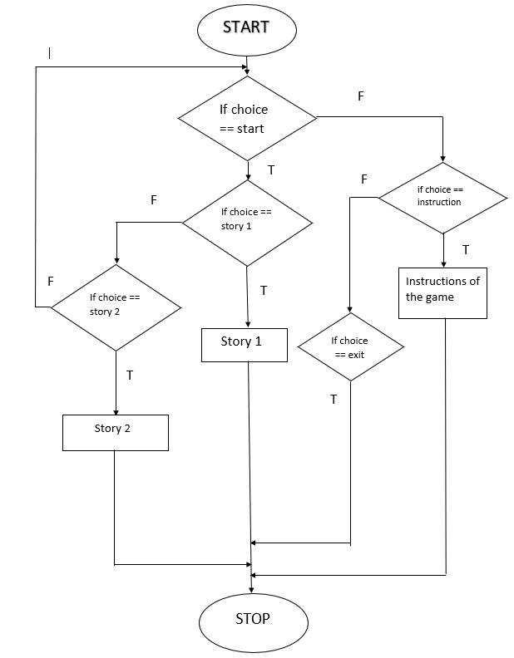
FLOWCHART

Slide 12
PSEUDO CODE
Main()
Animation()
If choice is start Game()
In game if choice is 1
Story 1()
In game if choice is 2
Story 2()
If choice is instructions
Instructions ()
If choice is exit
Exit ()

Slide 13
CODE SNIPPETS/ OUTPUTS
> The following slides includes the screenshots of user-defined functions and outputs.

Slide 14
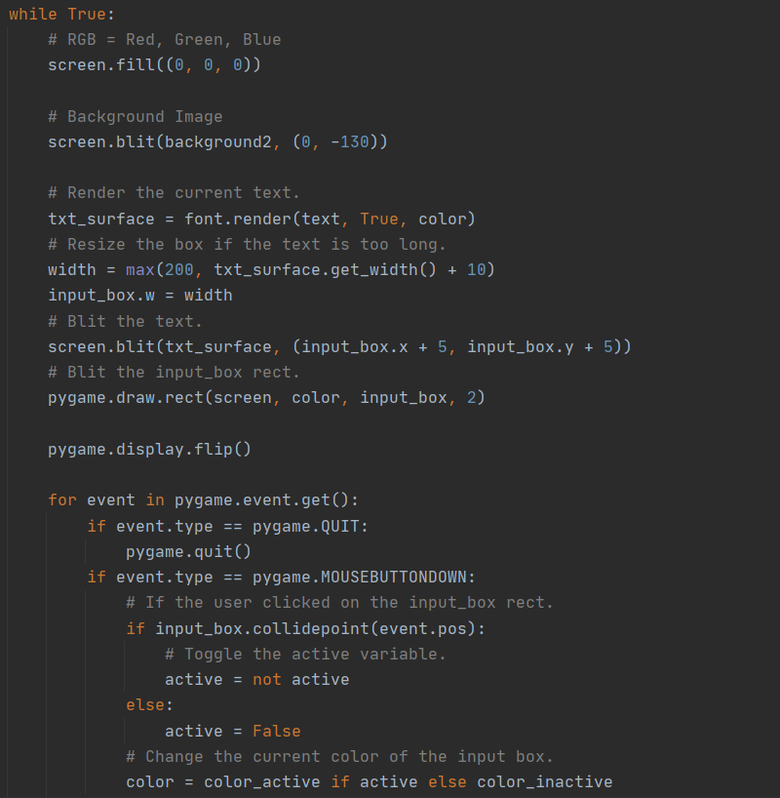
MENU PAGE CODE SNIPPET

Slide 15
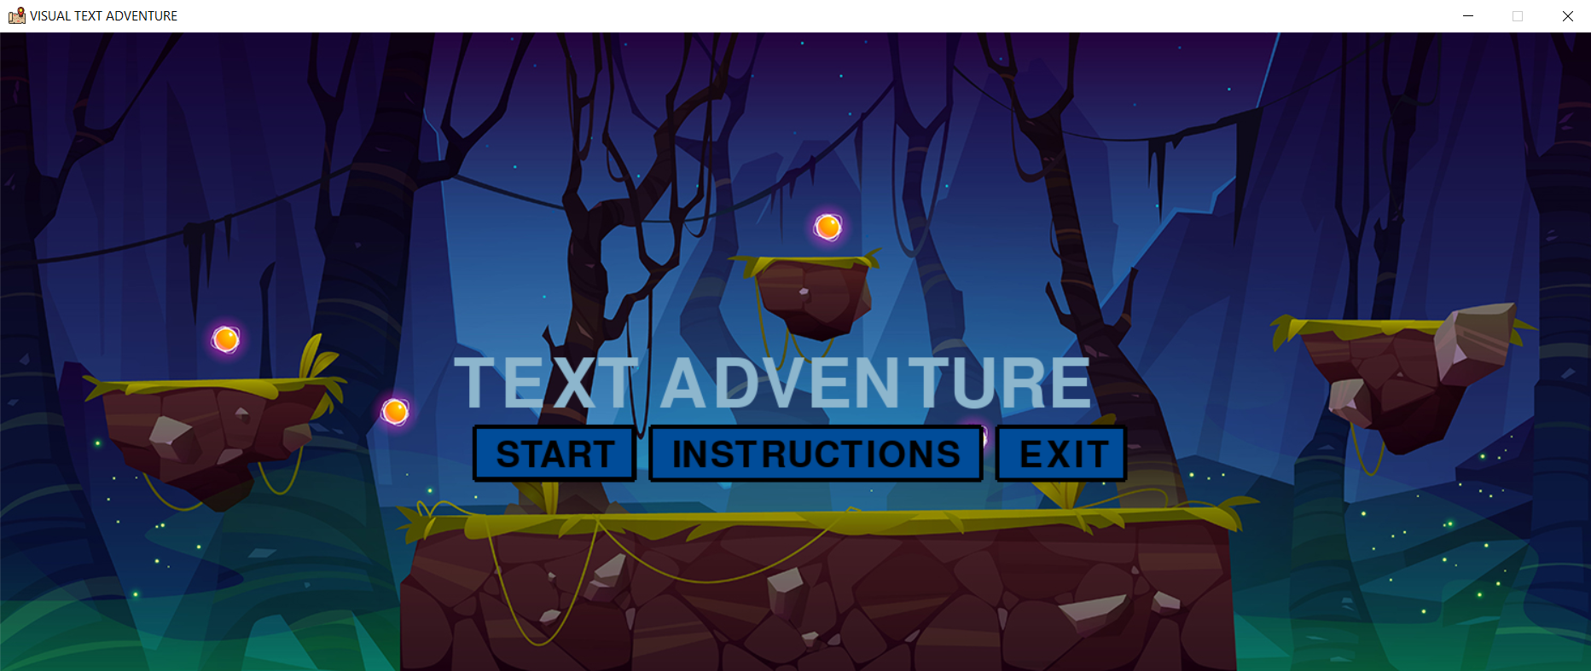
MENU PAGE

Slide 16
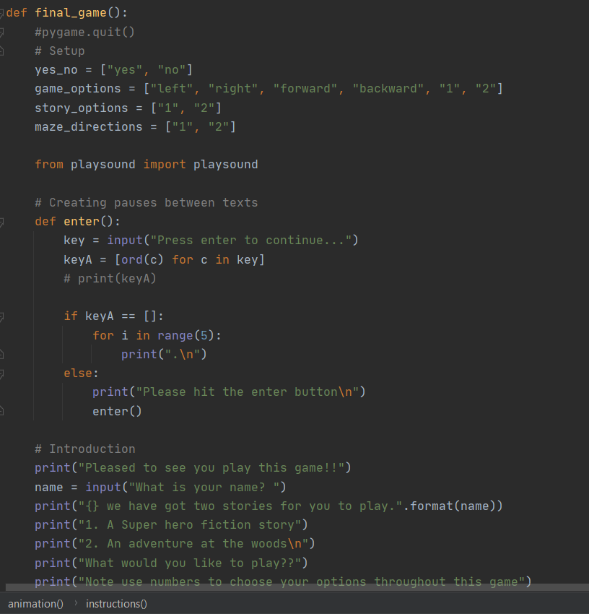
STORY SELECTION CODE SNIPPET

Slide 17
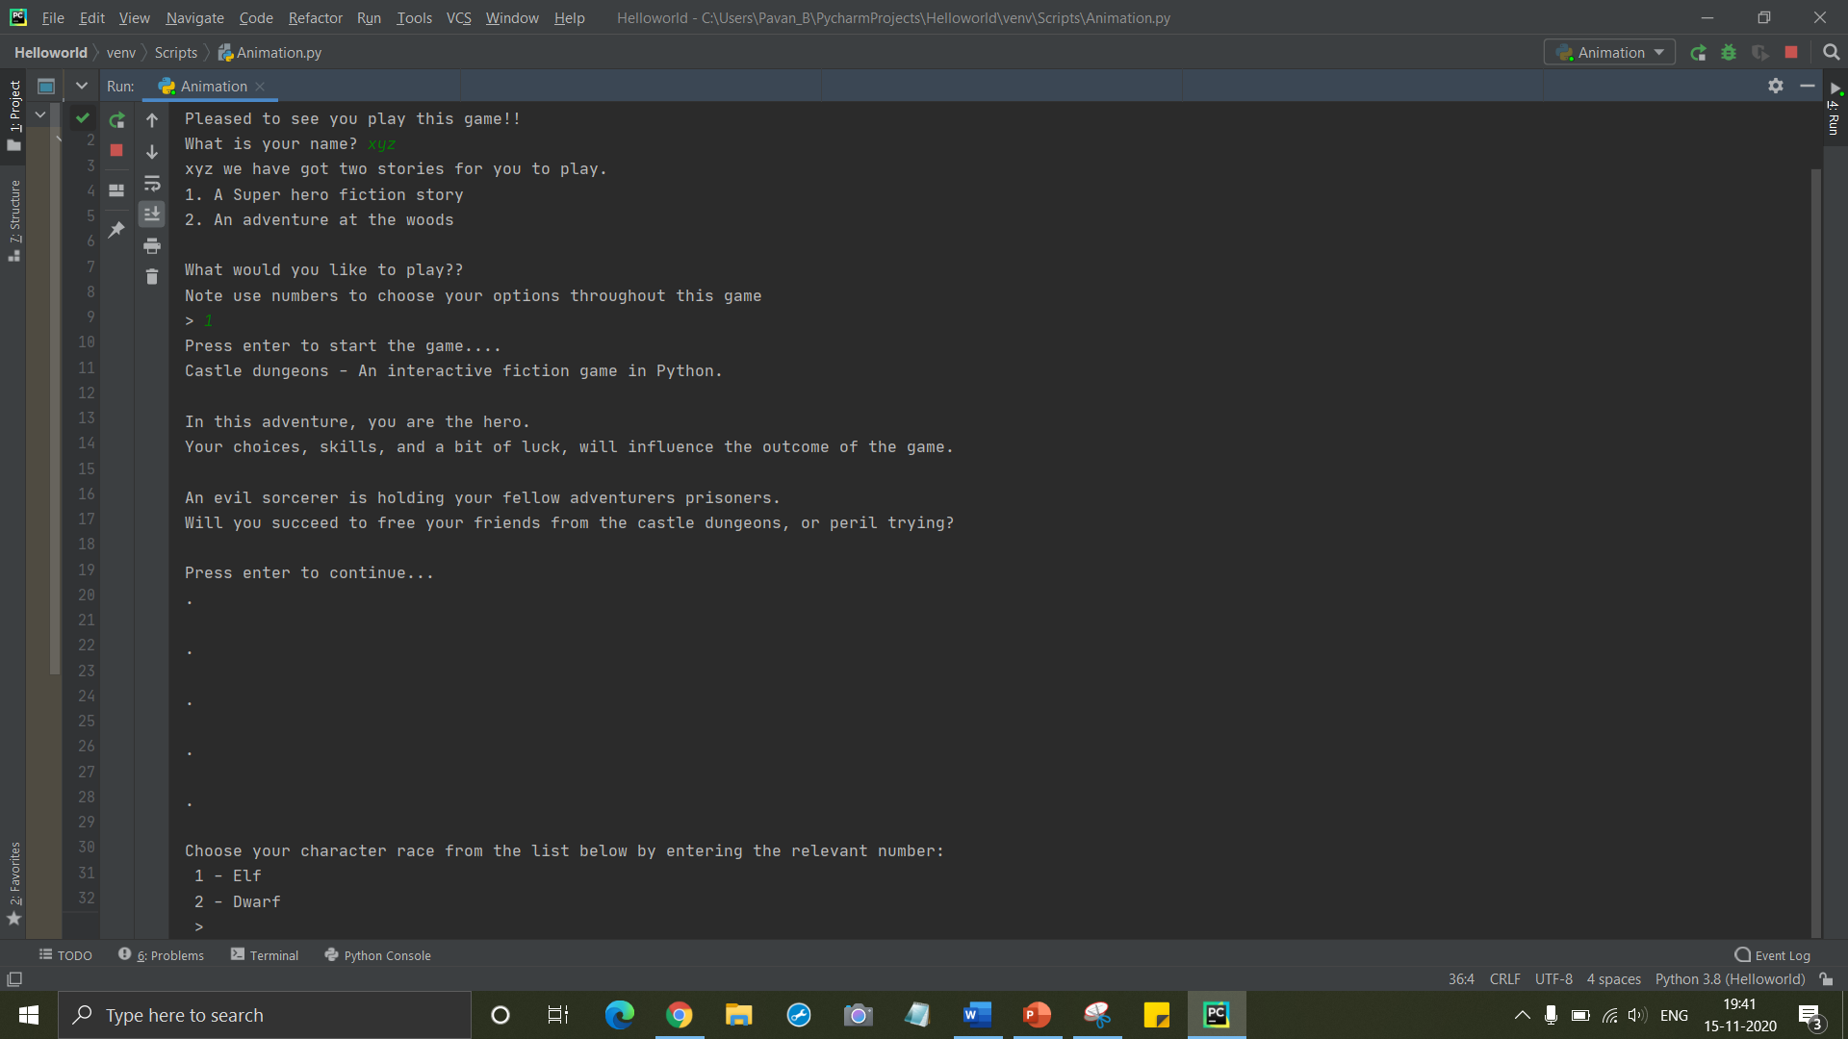
STORY SELECTION

Slide 18
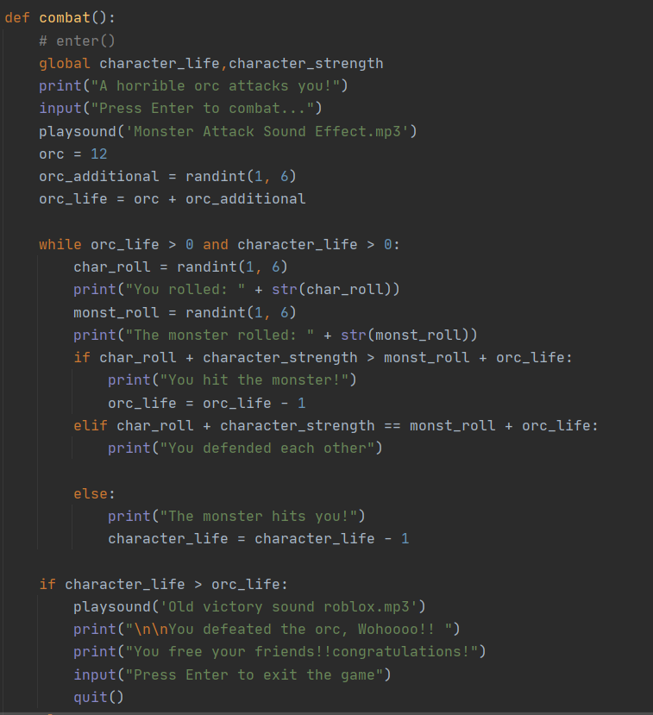
COMBAT CODE SNIPPET

Slide 19
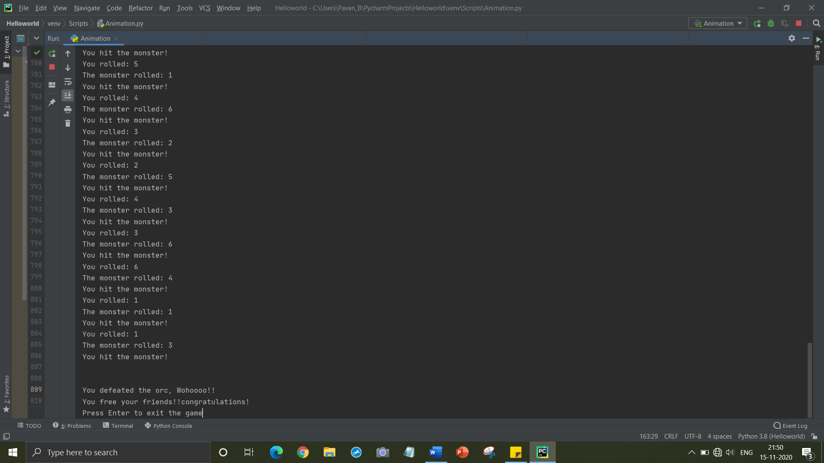
COMBAT: ORC V/S PLAYER

Slide 20
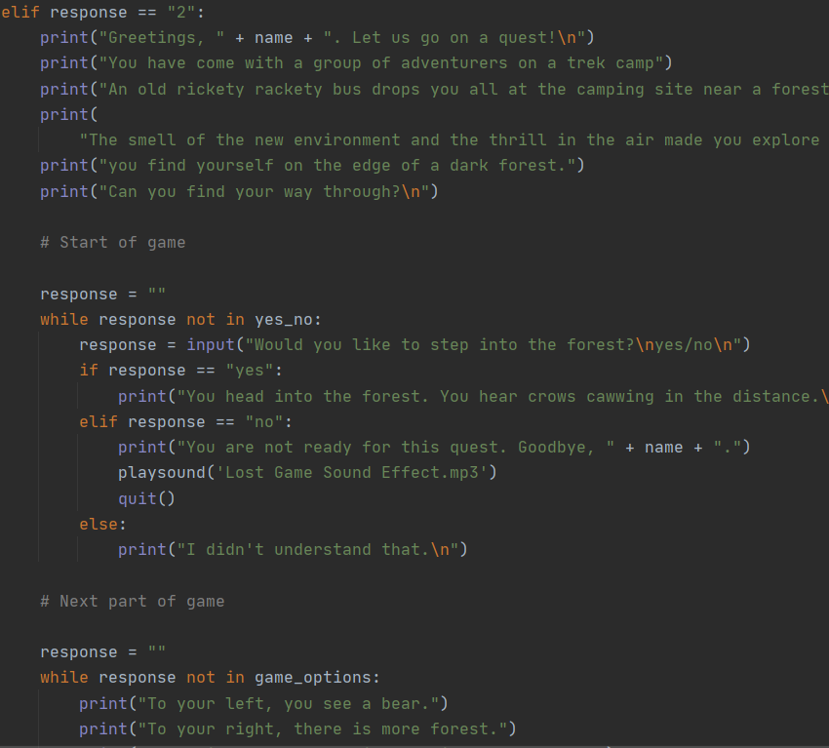
STORY 2 CODE SNIPPET

Slide 21
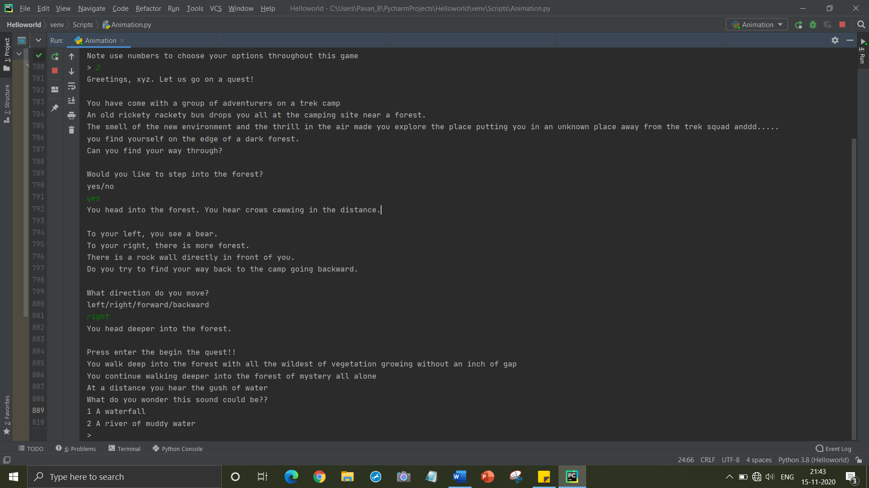
STORY 2 SELECTION

Slide 22


Slide 23
PROCESS
SOLUTION
CDDE
IDEAS
Executed, debugged and improved.
Putting all the innovative ideas into code.
Innovating different ideas into an creative story.

Slide 24

HARDWARE REQUIREMENTS
32/64 BIT CPU
MODERN OPERATING SYSTEM
1 GB FREE DISK SPACE
4 GB RAM

Slide 25

SOFTWARE REQUIREMENTS
COMPILER/ CODE EDITOR: ATOM
LANGUAGE: PYTHON 3

Slide 26

CONCLUSION
We learnt about the different libraries that python offers and how they can be used. For example like the pygame module, playsound module and many more.
In future we aim at making this game as an app to be easily downloadable and played by many.

Slide 27

FUTURE SCOPE
VIDEOGRAPHY
As all the textual and video graphical parts are complete we would like to take a step forward to video animating.
APP BASED
Making games App-based will encourage a lot more gamers to download and makes it user friendly.
MULTIPLE PLATFORMS
When it has availability in multiple platforms its easier for players to use in their own space.

Slide 28
RESOURCES
Coursera
Pythonlearn textbook
GeeksforGeeks
Python.org

Slide 29
Thank you Kavyashree ma’am!!
Thank you ma’am for giving us the opportunity to explore more about python and giving us guidance to complete the project successfully.

Slide 30
THANKS
Does anyone have any questions?
Email:
thiyagarajannarmatha@gmail.com
namitha.k0505@gmail.com
pavanb0308@gmail.com
neha15032001@gmail.com
nsgagan2001@gmail.com

